Slide 1
Customer Behavioral Analysis & Product Recommendation System (E-commerce)
An Exploration Into Product Recommendation Analysis & Modelling Techniques
-By Anshul Dabas

Slide 2
Agenda
Understanding Data
Exploratory Data Analysis
Data Modelling
Product Recommendations system
Conclusion
Future Scope

Slide 3
Understanding Data

Slide 4
Data Source & Collection
Kaggle Dataset : Multi-category Retail Online Store Data(For e.g. - Target or Walmart online platforms)
42.5 million records approximately(led to Scalability Issues)
3 million customers’ records
October,2019 (1-month) data of the platform
Each record represented a customer’s visit/event on the platform
Collected user, product and user-activities details

Slide 5
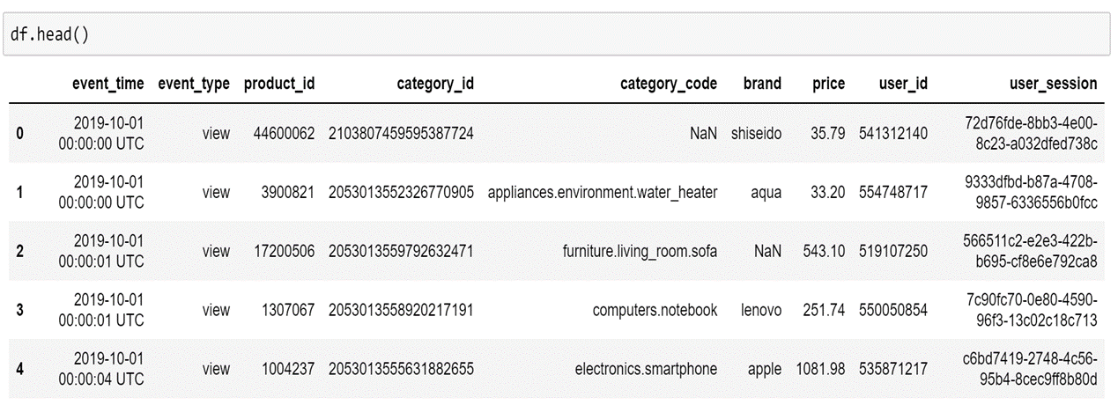
Data Definition & Details
User Details – user_id, user_session
Product Details – product_id, category_id, category_code, brand, price
User Activity Details – event_time, event_type
Derived feature – ratings
Each row = an event => View/ Add To Cart/ Purchase a product

Slide 6
Actual Task Definition/Research Question
Analyze customers’ behavior on a multi-category retail e-commerce platform with respect to products’ involved activities and use it to further build data modelling techniques to recommend products.

Slide 7
Exploratory Data Analysis

Slide 8
Customers’ Data Distribution
To understand customers diversity on the platform
Based on Customers’ visits
Exponential distribution
High Variance(~1000)
25% data as outliers
50% customers visited <= 4 times
25% customers visited (5-14 times)
Very less Purchase History on the platform
Mostly customers with product view as an activity in comparison to add to cart and purchase activities.

Slide 9
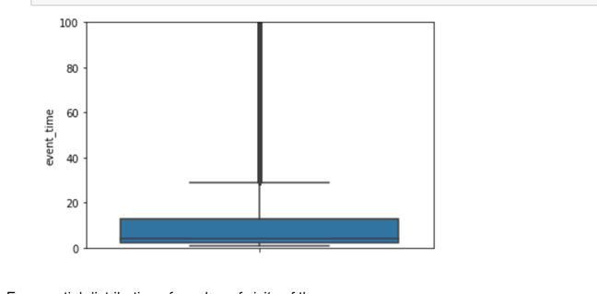
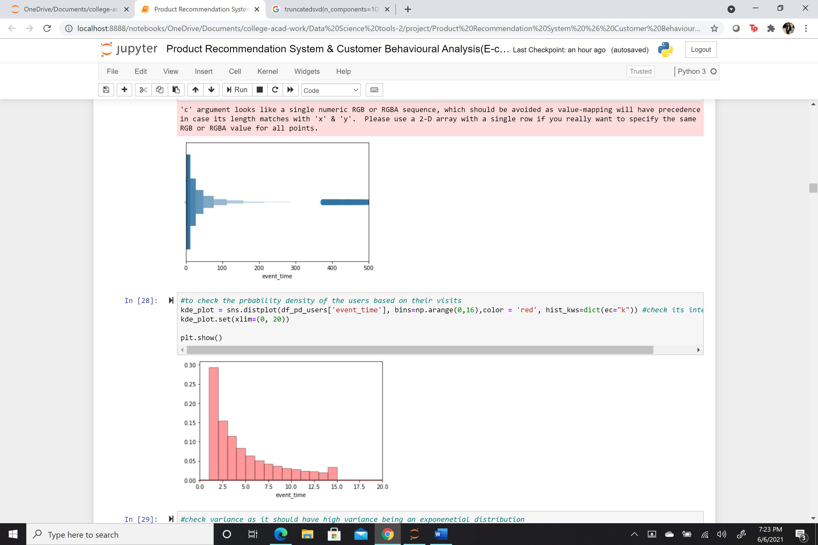
Customers’ Data Distribution
event_time = Number of times a user visited the platform including all types of events (view/card/purchase)

Slide 10
Customers’ Data Distribution
Customers’ Groups
Group-1
Visits<=4
Group-3
All outliers(>15)
Group-2
Visits<=15

Slide 11
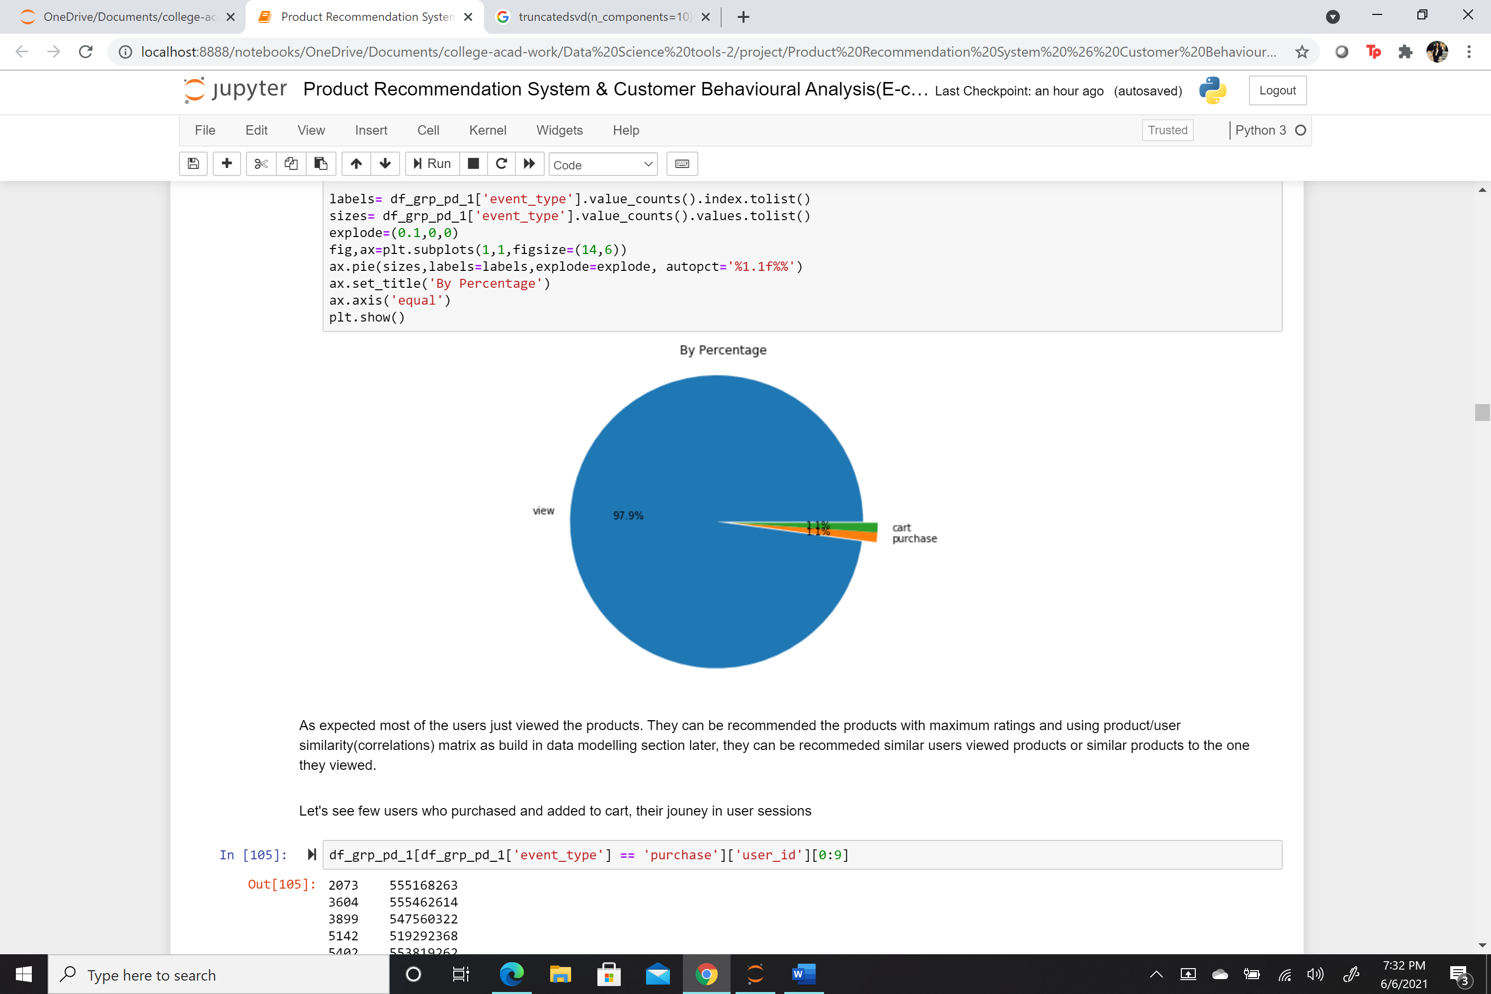
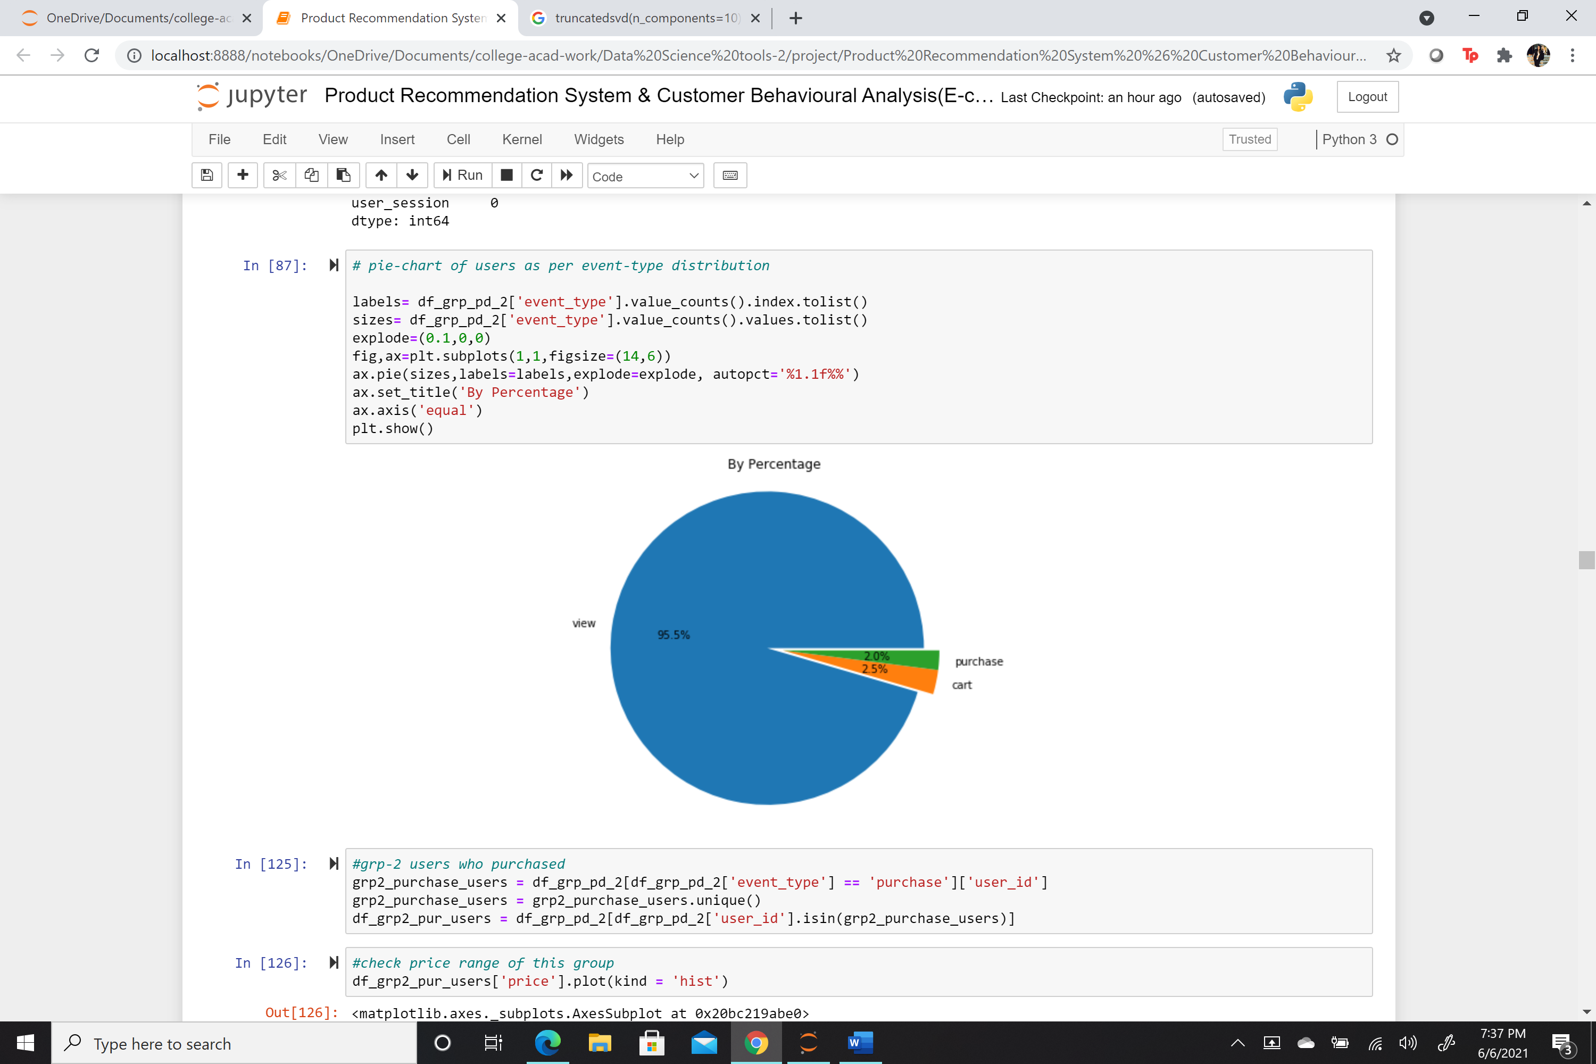
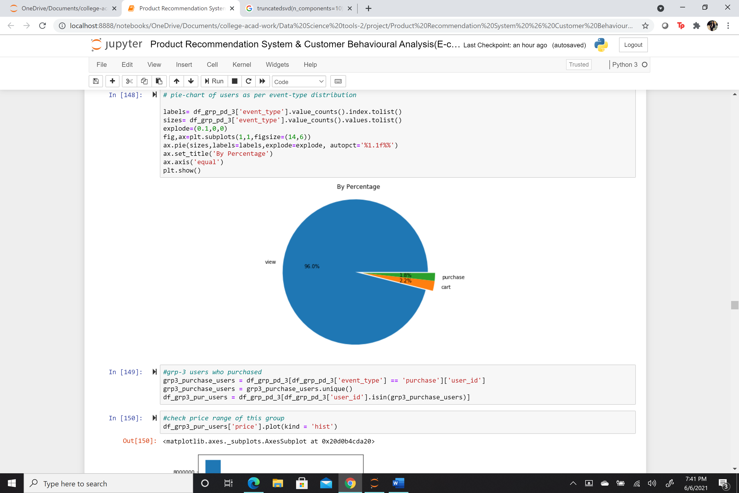
Group-wise Customers’ Data Analysis
users’ distribution based on platform activities
Group-1
Group-2
Group-3

Slide 12
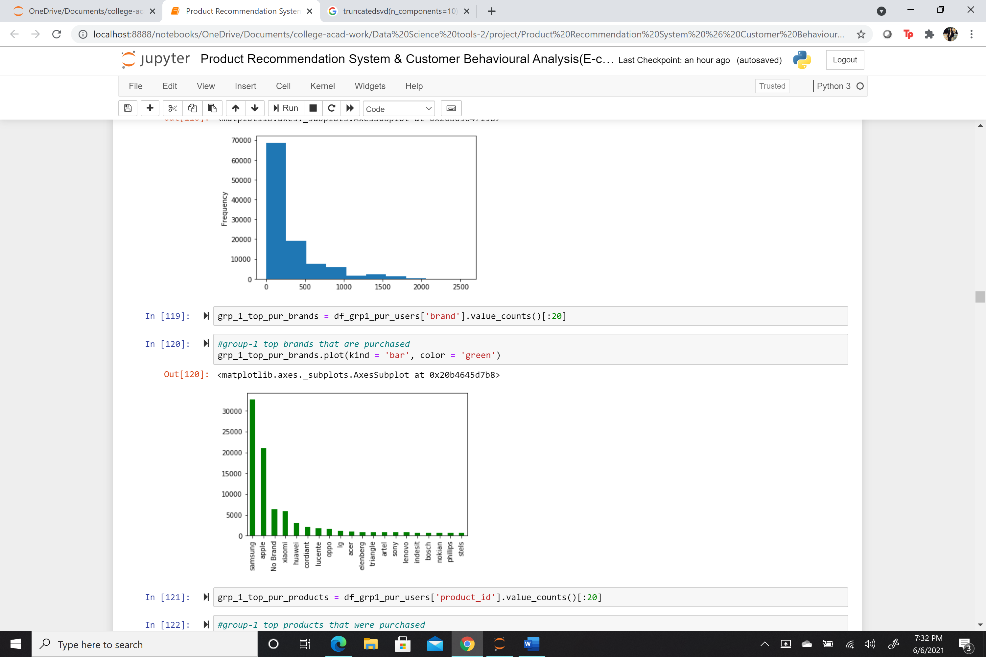
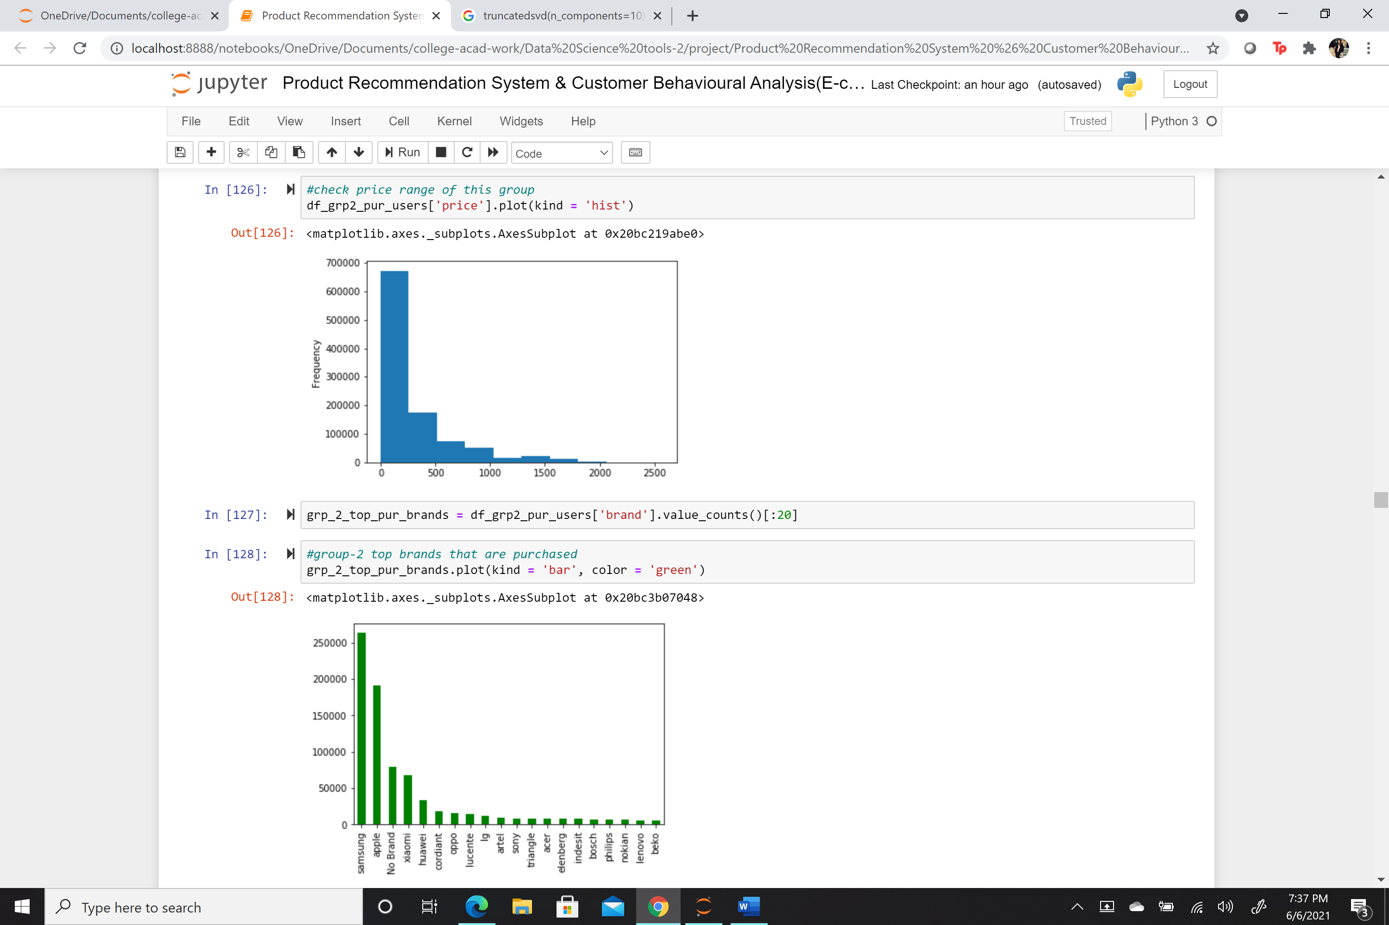
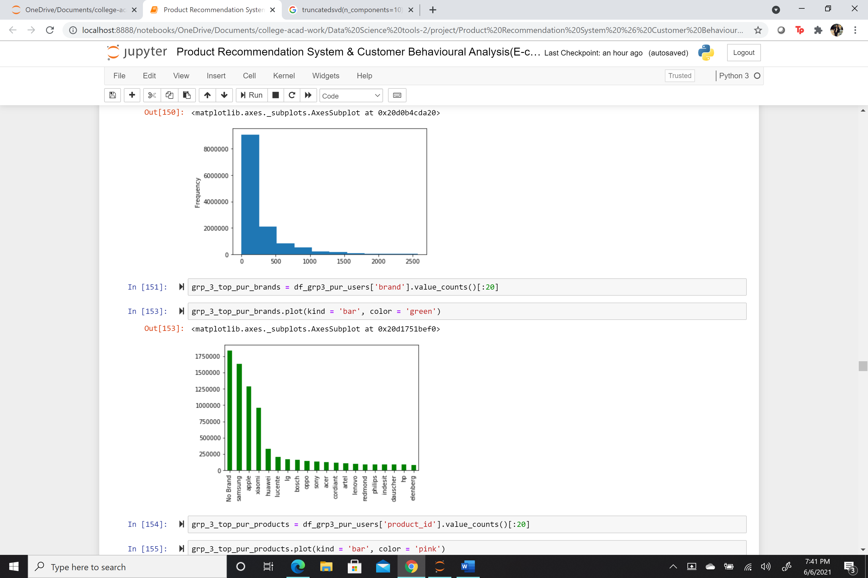
Group-wise Customers’ Data Analysis
Price Range Interests & Top Brands Purchased
Group-1
Group-2
Group-3

Slide 13
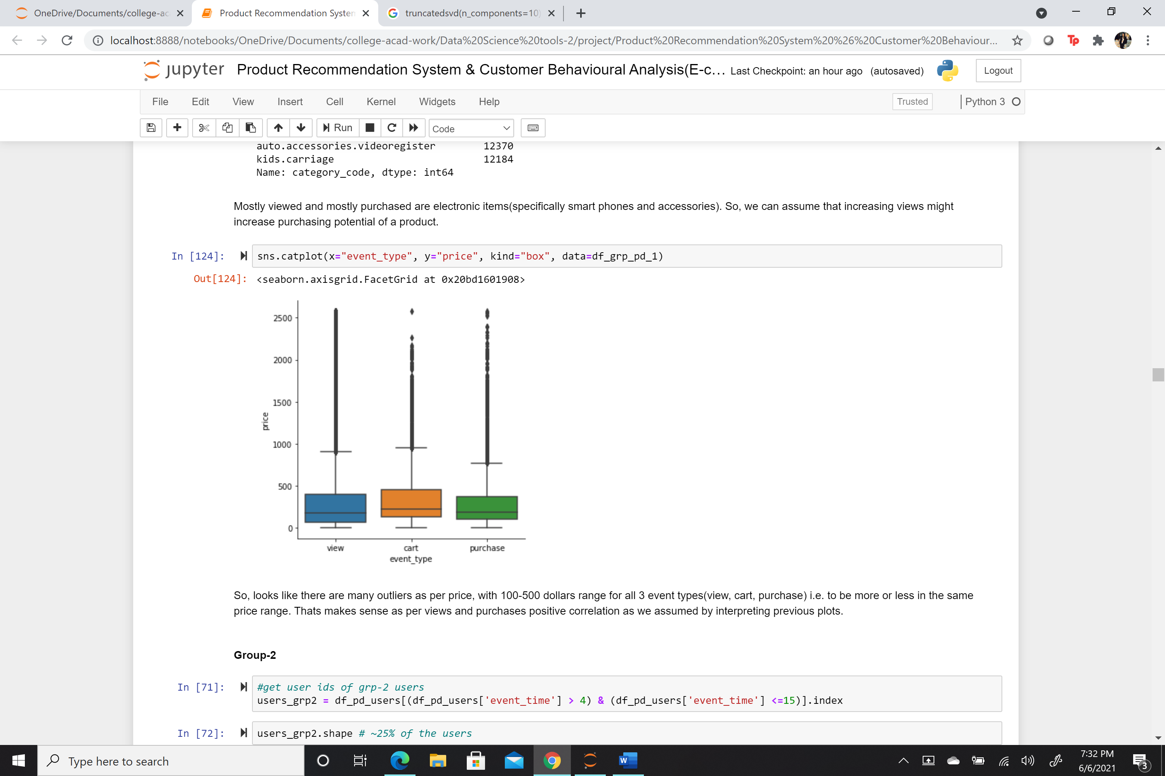
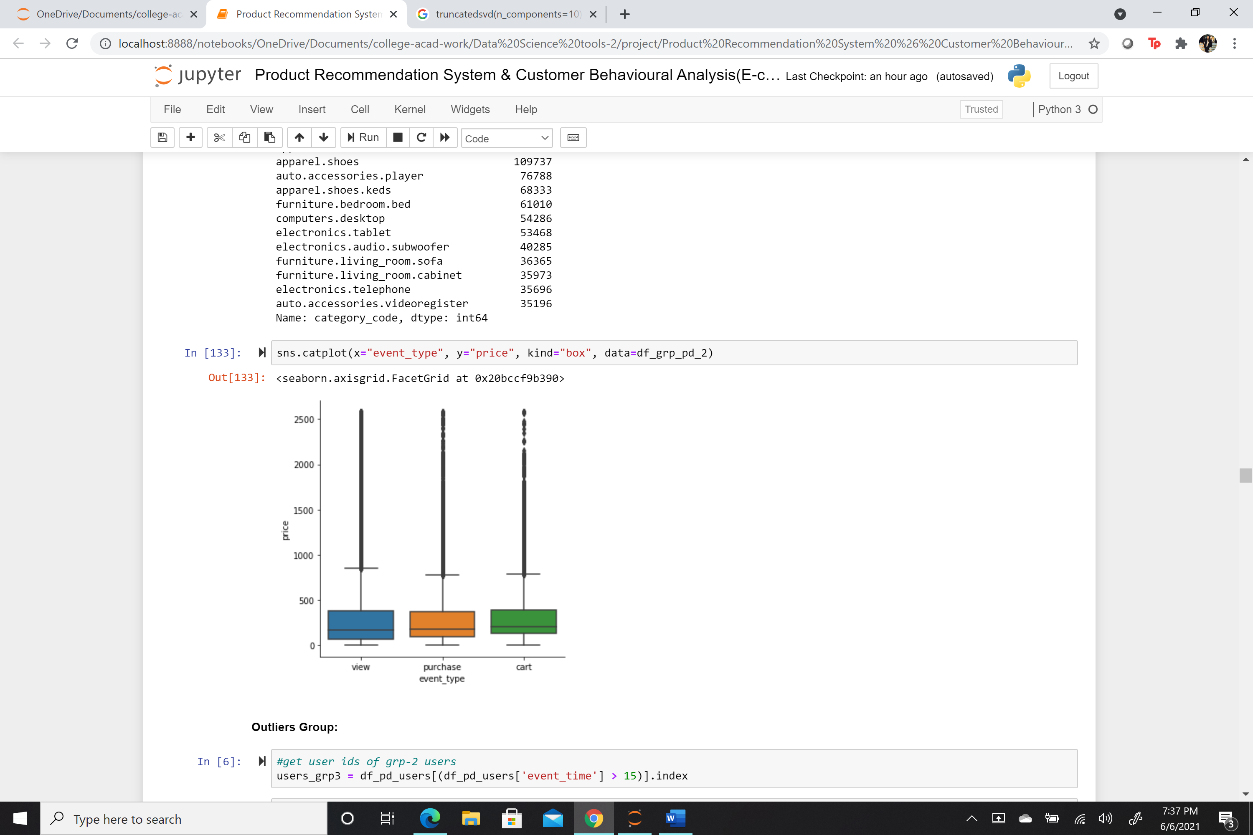
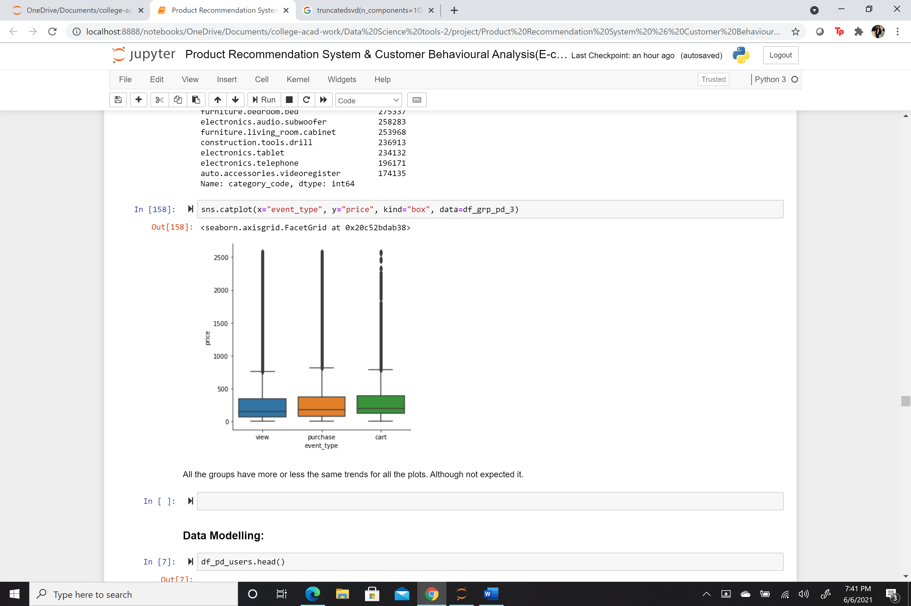
Group-wise Customers’ Data Analysis
Price range interests as per users’ activity
Group-1
Group-2
Group-3

Slide 14
Group-wise Customers’ Data Analysis
Majority of the users in each group only viewed products on the platform
Only 1-2% users purchases products in each group
Surprisingly, similar interest in price ranges and brands
No significant behavior difference inferred via groups based on visit frequency

Slide 15
Data Modelling

Slide 16
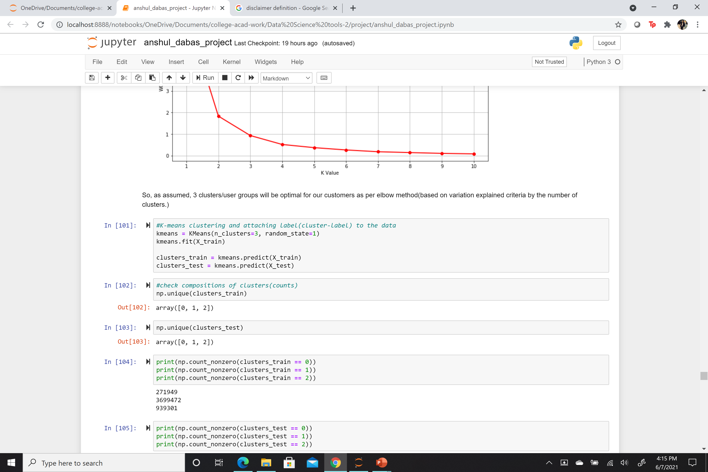
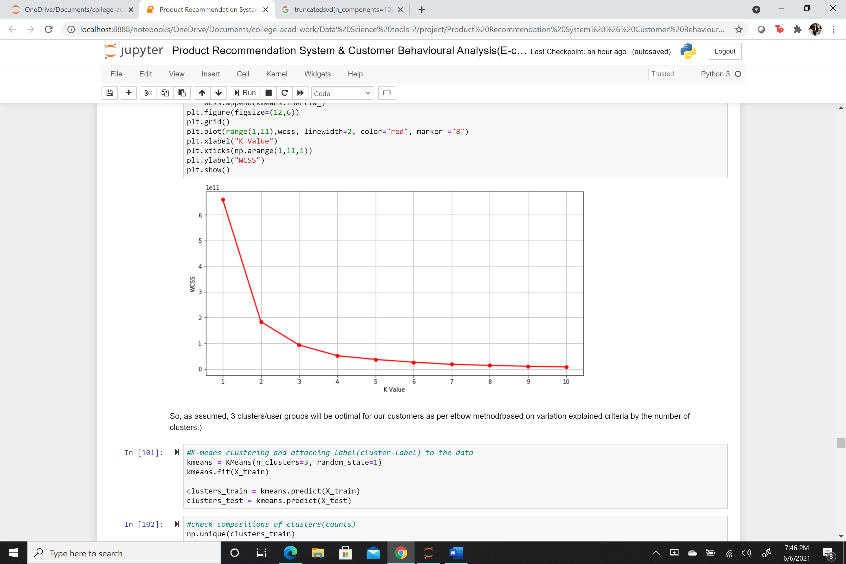
K-Means Clustering
1. All missing values and outliers handled
2. To group similar users in a group and find different users’ behavioral groups based on event types, price and ratings.
3. Optimal groups as per elbow methods = 3
4. Target users as per their cluster/group traits by using purchase history data of the respective group

Slide 17
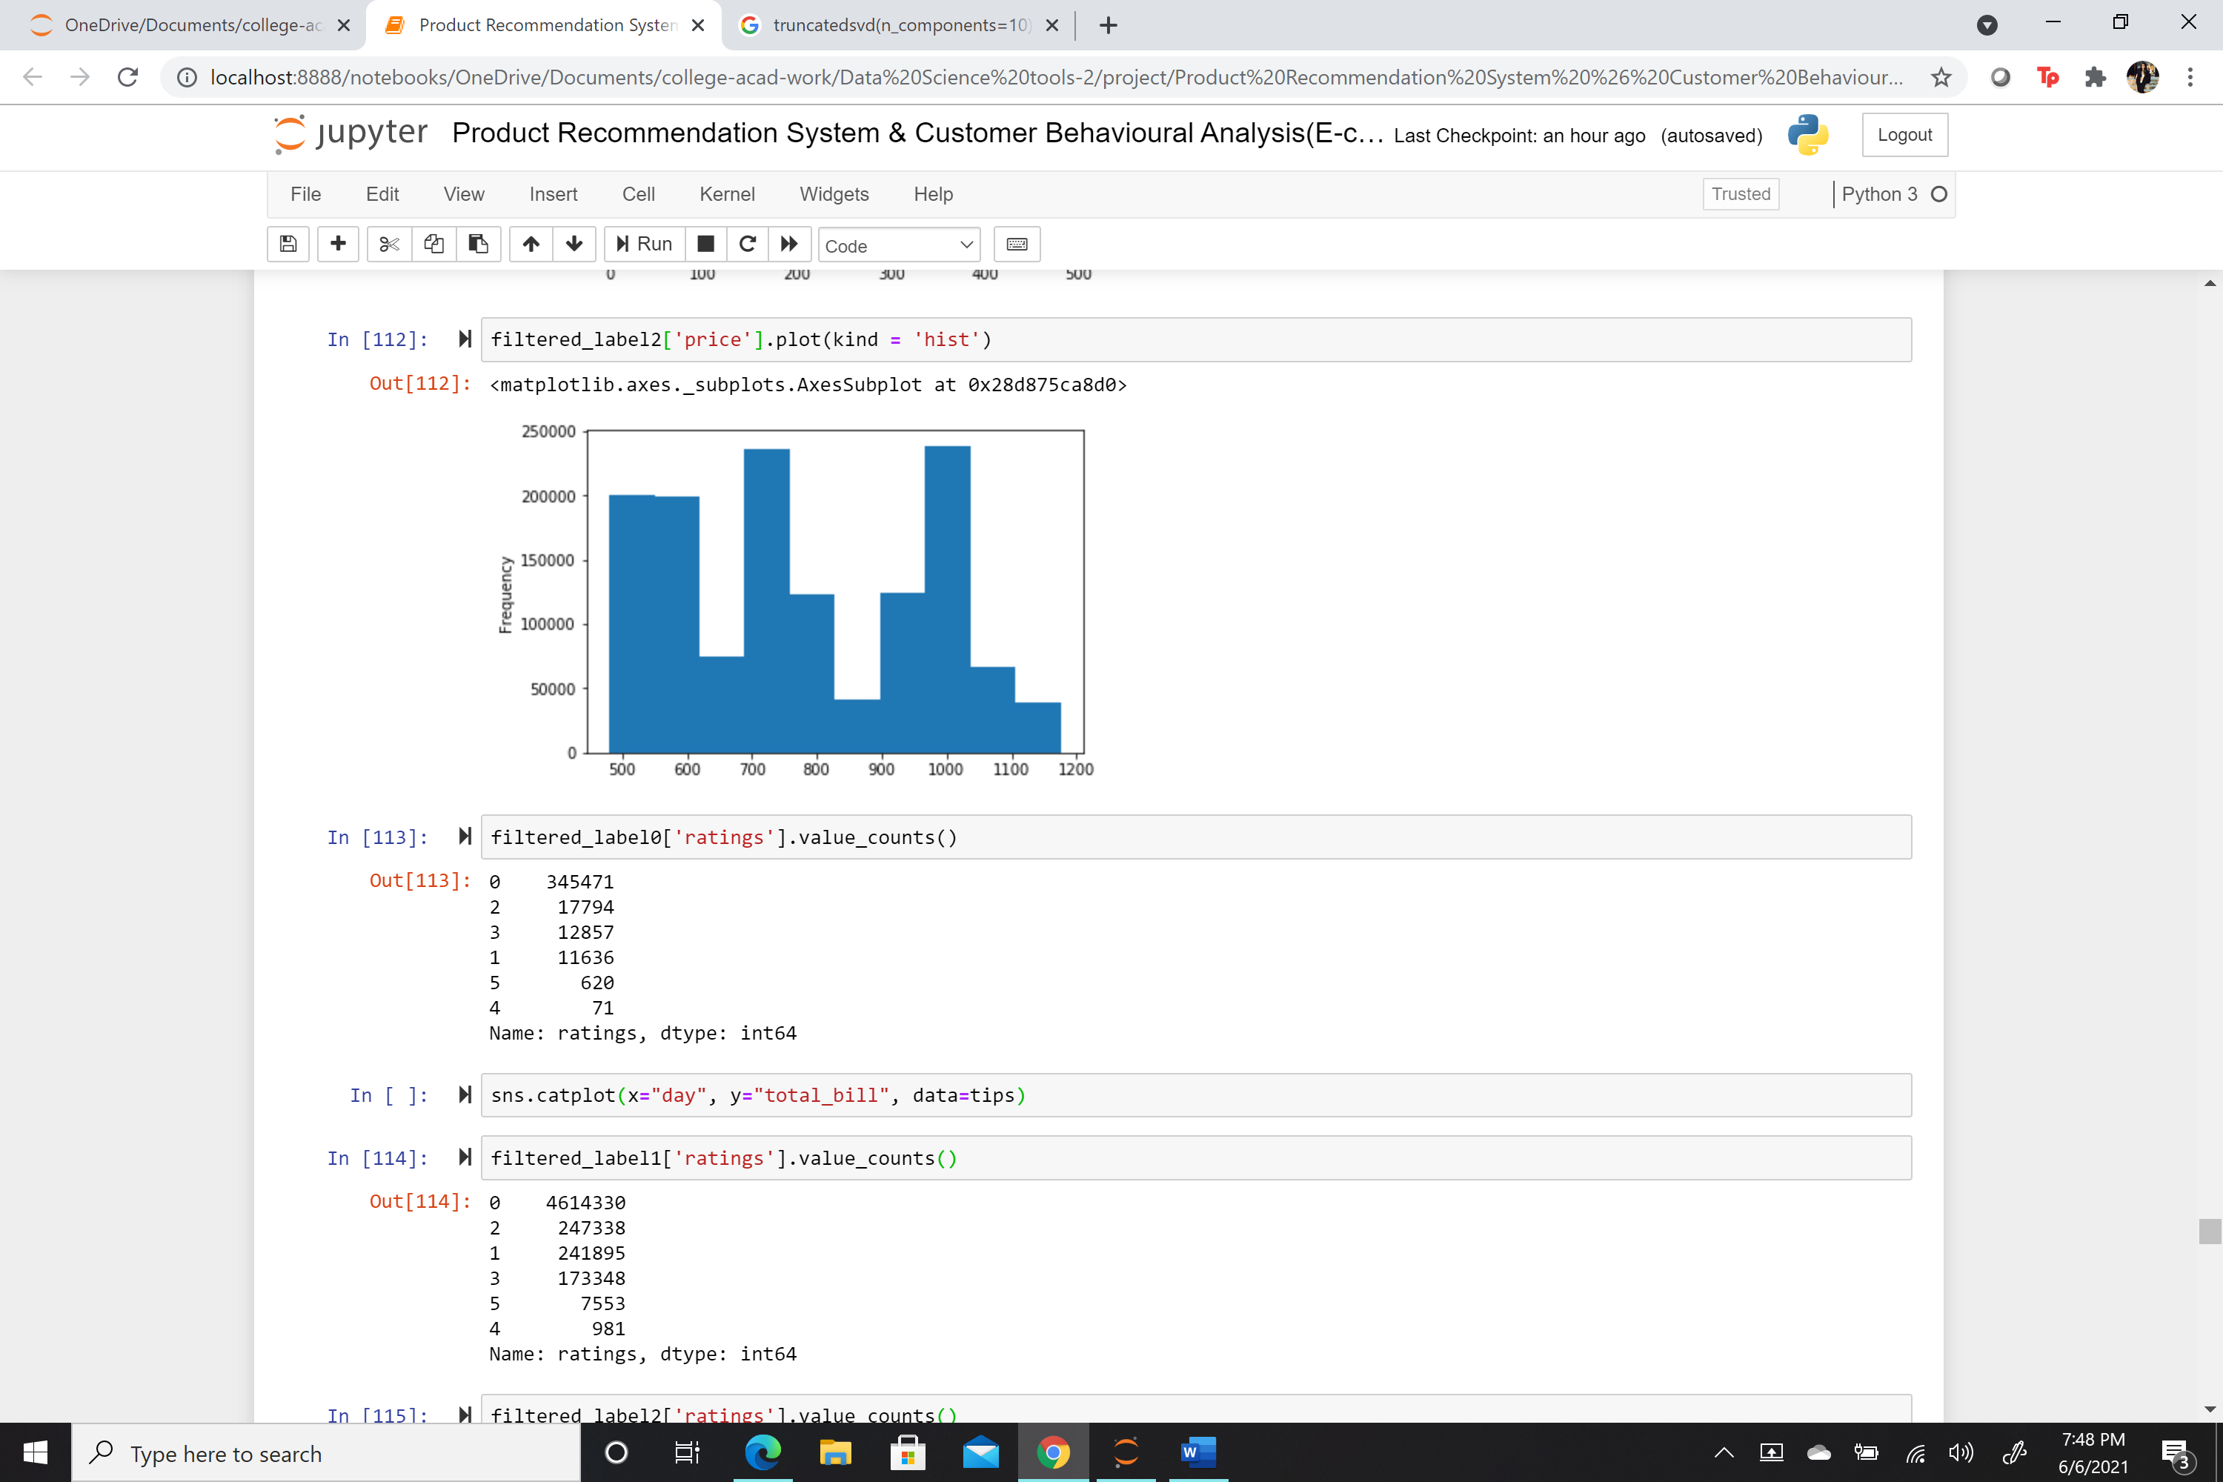
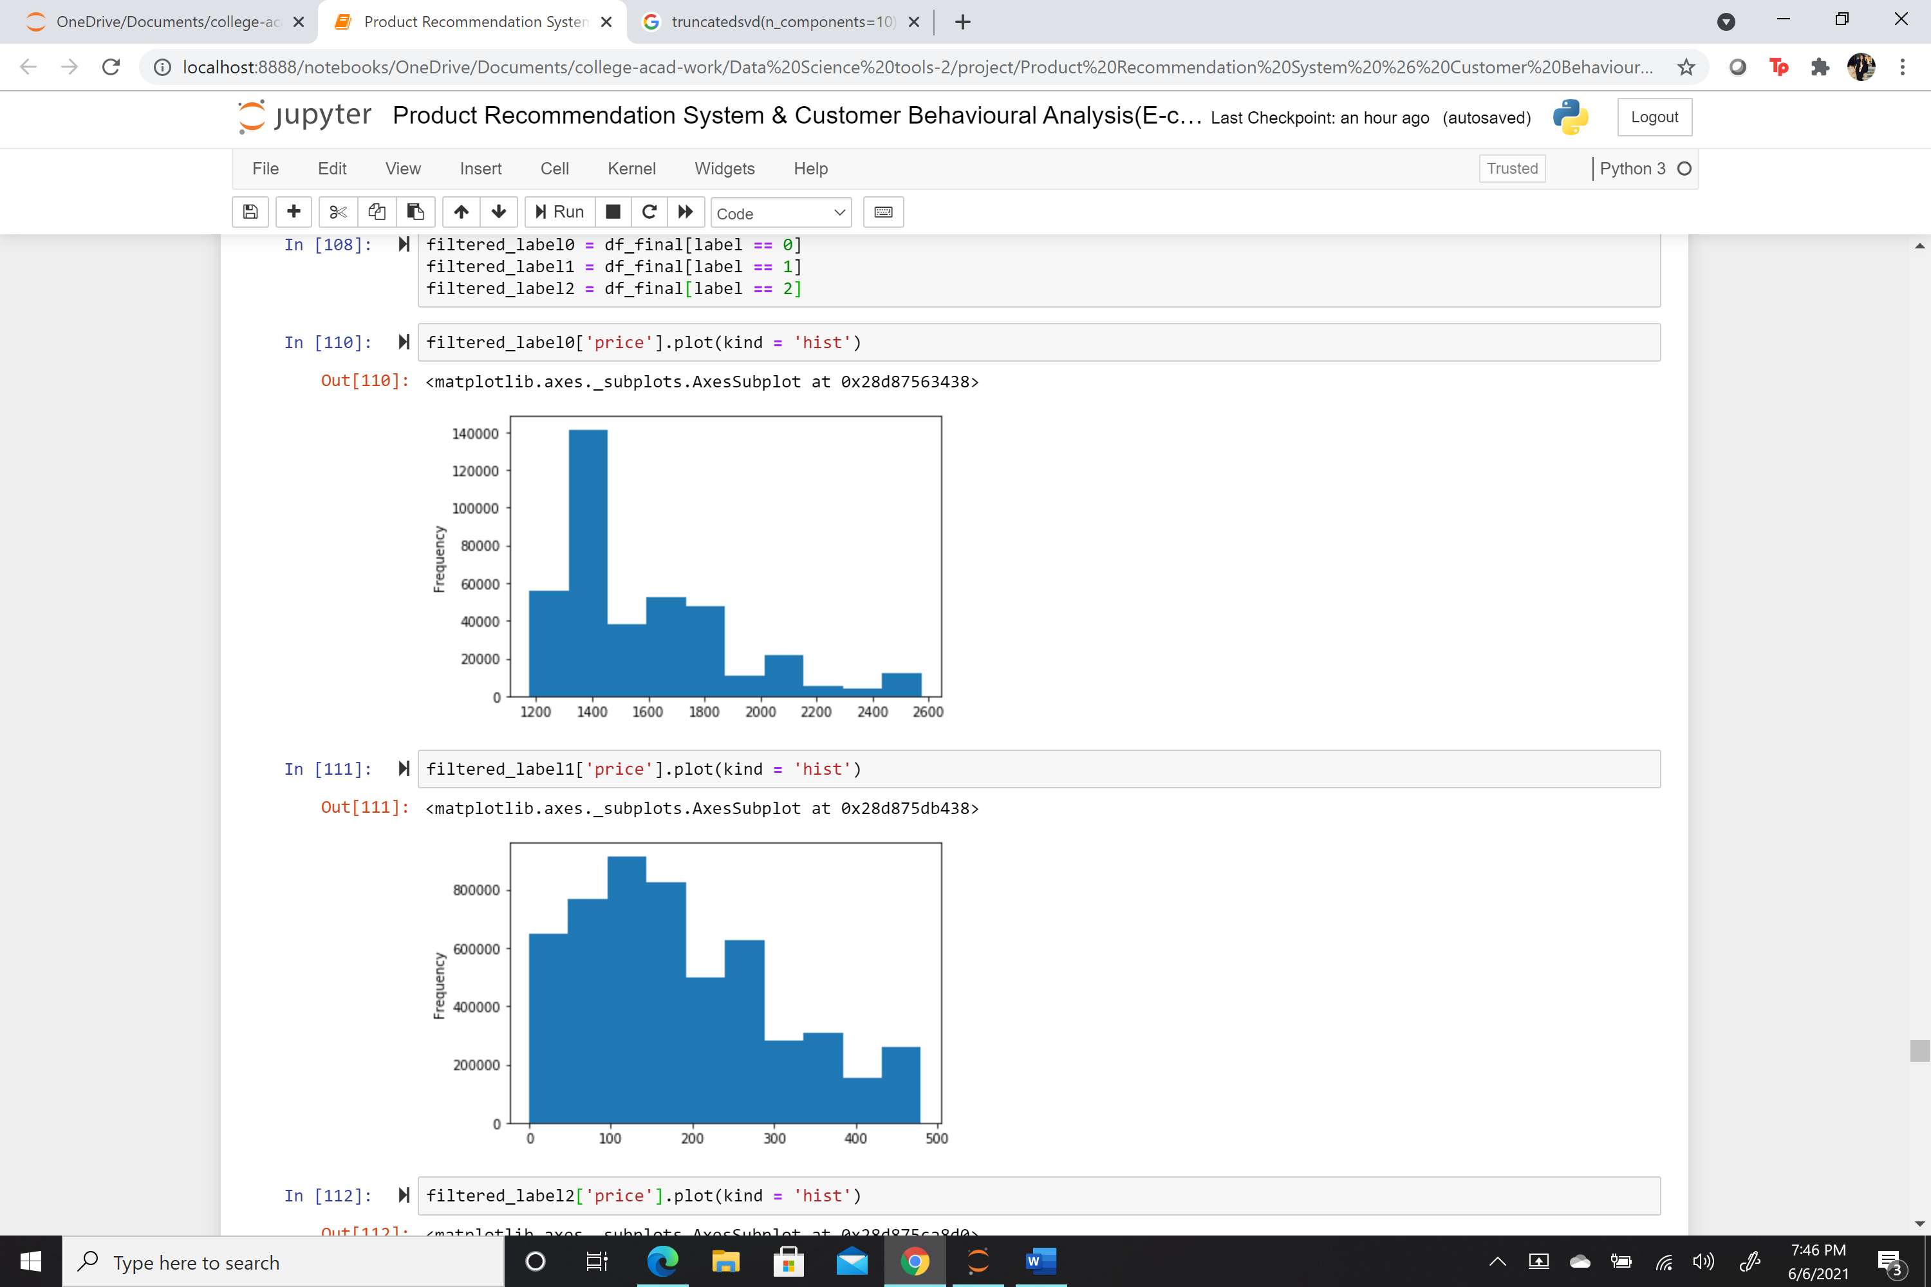
K-Means Clustering
Price range interest trait of different clustered customers’
Likewise, extract different traits of each cluster to infer users’ behavior based on products and other activities details to understand their needs/interests’ and target them accordingly.
Important Note: Use top rated and purchased products of each cluster as recommendations for new users to the platform.

Slide 18
Product Recommendations System

Slide 19
Basic Concepts
Recommendation Types
Content Based Filtering
(Use Analyzed Traits)
Hybrid Filtering
(Both)
Collaboration Based Filtering
(Find similar users(product likelihood), correlated products)

Slide 20
Collaboration Filtering in each cluster based on Purchase History
Apriori Algorithm to find association patterns among products
Apriori Algorithm to find association patterns among users
Product Utility Correlation Matrix based on product ratings

Slide 21
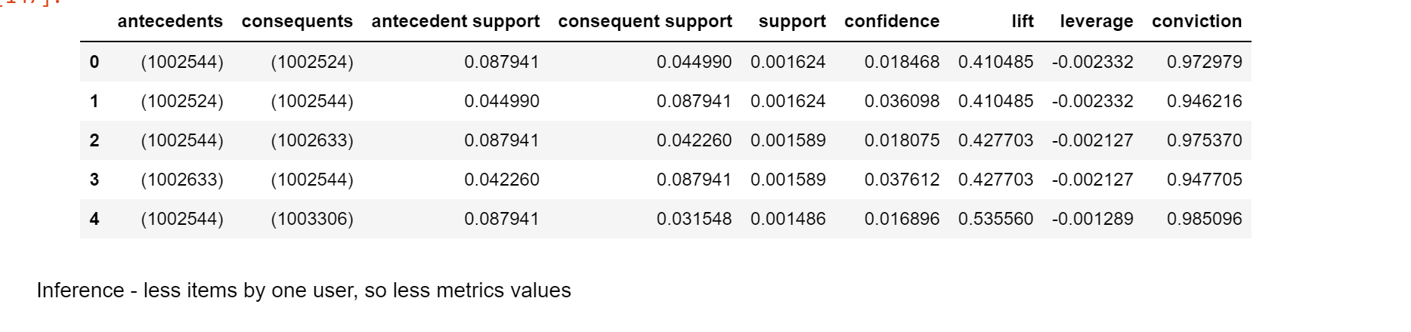
Apriori Algorithm
Based on association rules (E.g. : A -> B or A,B -> C )
Helps in pattern recognition of the itemset (E.g. : Products)
Metrics used - support, confidence and lift to find significant strong associations
Due to less purchase history could not find strong associations. As the purchase history will increase, the metrics performance will improve

Slide 22
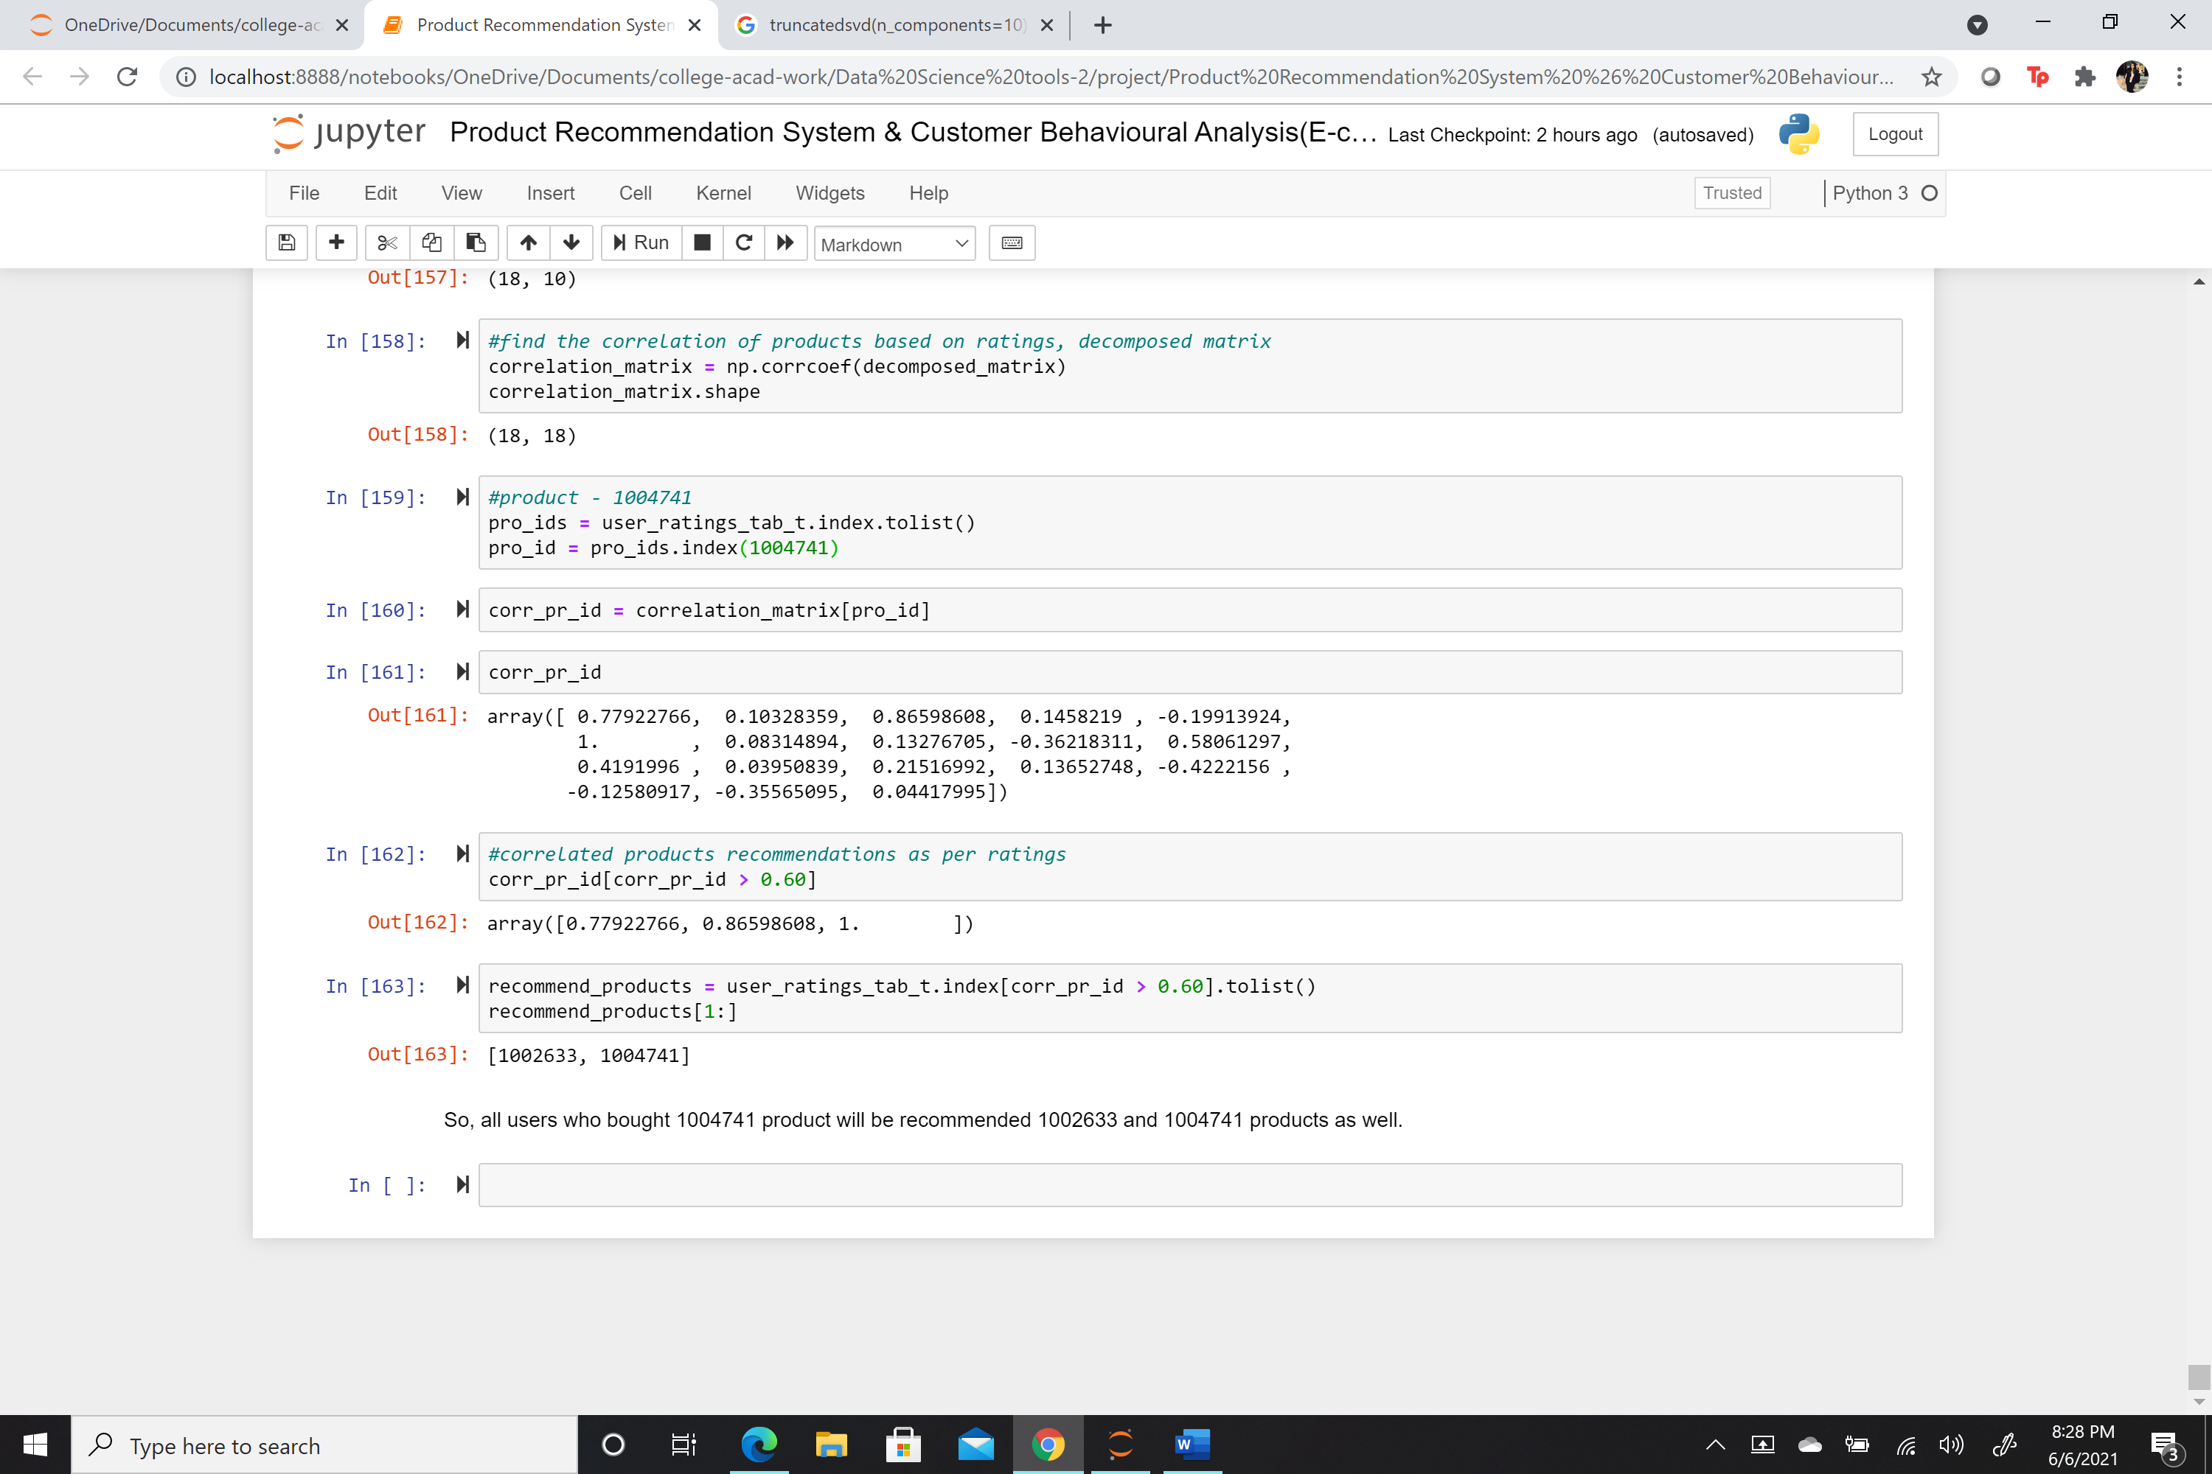
Product Utility Correlation Matrix
Used ratings(utility metric) for the products to built their correlations
It will recommend the products based on a user’s previously given ratings for purchased products.

Slide 23
Conclusion
For new users, recommend analyzed top traits(content-based filtering) like target price ranges, top categories or products.
For other users, cluster the users into a similar group. Use the products’ purchase history in each cluster to recommend products using collaborative filtering techniques.
It will help to target most likely requirements of the customers to increase platform’s user-engagement and profit in terms of sales.
Like purchase history techniques, we can use views history to recommend products

Slide 24
Future Scope
Scalability issues can be resolved by using distributed and parallel processing technologies like Spark. Although, DASK data frames were used in the project, but they lacked in various functionalities and inefficient in some computations.
Working on views history of the customers
Other techniques like neural networks can be applied to develop recommendation systems
Usually, the performance criteria for recommendation can be observed with increase in user-engagement or purchases, still accuracy or performance criterion can be developed to understand the efficiency of the system.

Slide 25

Thank You!!!!

Slide 26

Questions ?????

